Slide 1

Library Management
Guide by : - Ms. Arpita Roy
Project by :- Fireflies

Slide 2
Content
Project Overview
Problem Statement
Solution and its value
Technology
Who are the end users
How can help people ?
Wow Moment
Result
Conclusion

Slide 3
Project Overview
The Library Management System project aims to modernize library services, providing a technologically advanced and user-centric platform that enhances efficiency, user satisfaction, and overall library management.

Slide 4
Problem Statement
Manual processes for book checkout, return, and inventory management lead to errors, time-consuming procedures, and a lack of real-time information. Faces numerous inefficiencies and challenges that hinder the seamless operation of the library. Additionally, the absence of an integrated system makes it difficult to track overdue books, manage memberships, and optimize resource allocation.

Slide 5
Solution and its value
The Modern Library Management System project is not just a technological upgrade but a strategic initiative to transform the library into a modern, user-centric, and efficiently managed space.
Through library management, we aim to revolutionize the way our library operates, ensuring that it remains a hub of knowledge and a seamless resource for our academic community.

Slide 6
Technology
Using technologies in this project
Html
Css
Python
Django
Php
MySql DataBase

Slide 7
Who are the end users
Students can use this Web Application
and you all can also use this Web Application.

Slide 8
How can help people ?
A Library Management System (LMS) helps people by providing efficient access to resources, streamlining borrowing processes, ensuring real-time tracking of materials, enhancing user experience through improved interfaces and communication, enabling data-driven decision-making, and offering remote accessibility to library services. Finding any book is easy, as we can place each book in different sections, making it convenient for us to locate any book.

Slide 9
Wow Moment
The 'wow moment' in this online library that allows
us to read from anywhere using mobile, laptop, etc. and enables
us to check the availability of each book from any location.

Slide 10
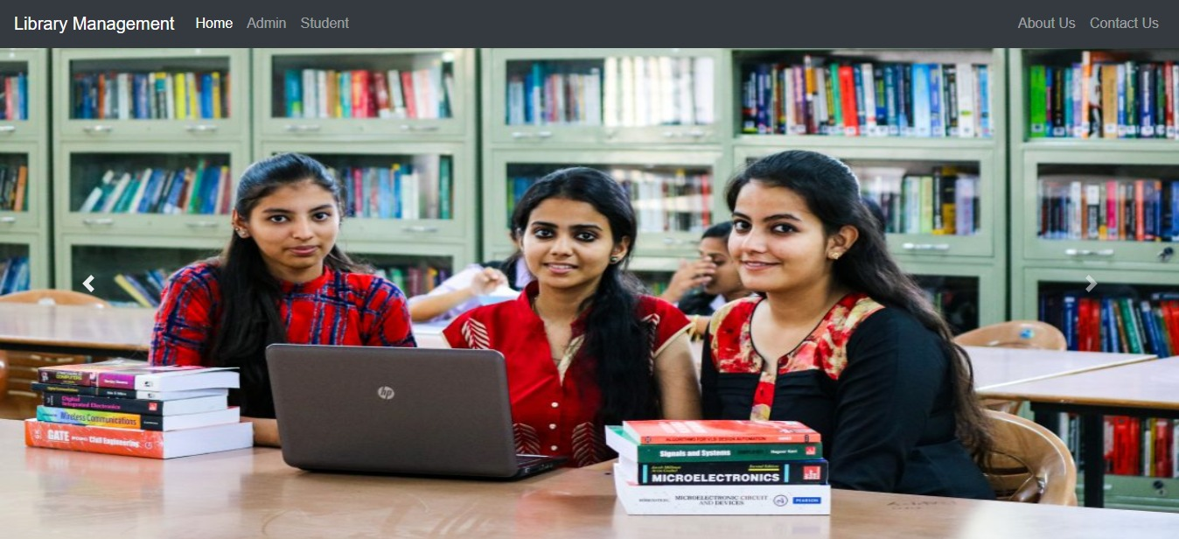
Result

Slide 11


